Slide 1
Fibonacci heap
Programming Domain

Slide 2
Fibonacci Heap
A fibonacci heap is a data structure that consists of a collection of trees which follow min heap or max heap property
In a fibonacci heap, a node can have more than two children or no children at all.
Notes:
Insert a map of your country.

Slide 3
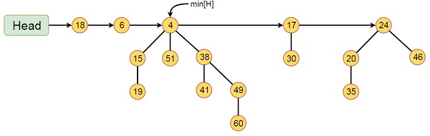
This Fibonacci Heap H consists of five Fibonacci Heaps and 16 nodes.
The line with arrow head indicates the root list. Minimum node in the list is denoted by min[H] which is holding 4
Notes:
Insert a map of your country.

Slide 4
Properties of a Fibonacci Heap
It is a set of min heap-ordered trees. (i.e. The parent is always smaller than the children.)
A pointer is maintained at the minimum element node. It consists of a set of marked nodes. (Decrease key operation)
The trees within a Fibonacci heap are unordered but rooted
Notes:
Insert a map of your country.

Slide 5
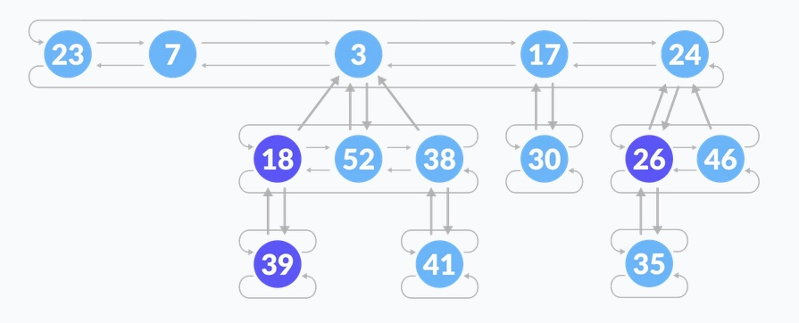
Memory Representation
The roots of all the trees are linked together for faster access.
The child nodes of a parent node are connected to each other through a circular doubly linked list
Notes:
Insert a map of your country.

Slide 6
Inserting a node
Create a new node for the element.
Check if the heap is empty.
If the heap is empty, set the new node as a root node and mark it min.
Else, insert the node into the root list and update min.
Notes:
Insert a map of your country.

Slide 7
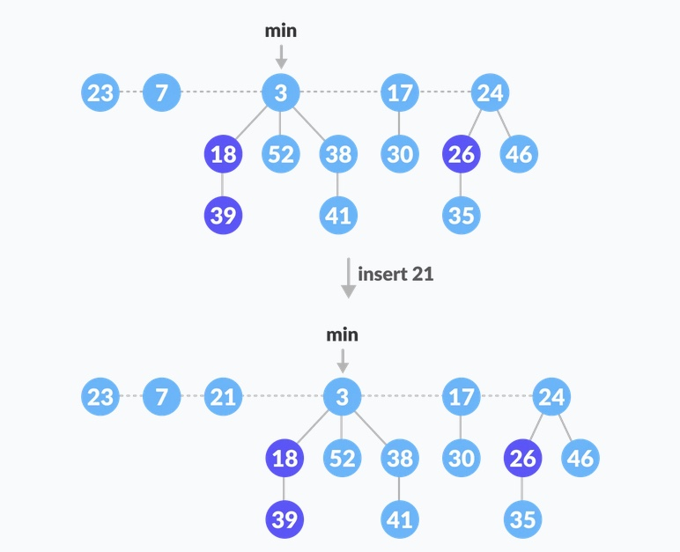
Notes:
Insert a map of your country.

Slide 8
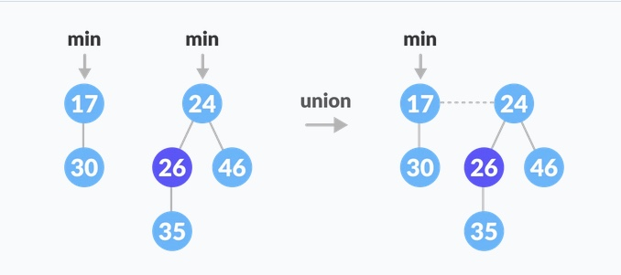
Union
Concatenate the roots of both the heaps.
Update min by selecting a minimum key from the new root lists.
Notes:
Insert a map of your country.

